Slide 1
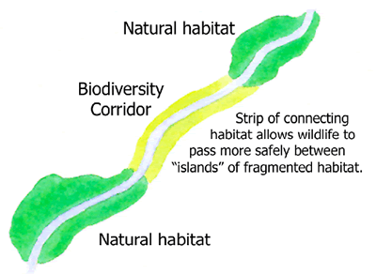
Corridors
Habitat Corridor
Transportation Corridor
Utility Corridor
www.cvconservationstrategy.org
2013
Farr 2008
Notes:
Transportation Corridor
Road
Rail
Bike
Utility Corridor
Gas
Water
Sewer
Electricity
Data
Use Borlange as example?

Slide 2
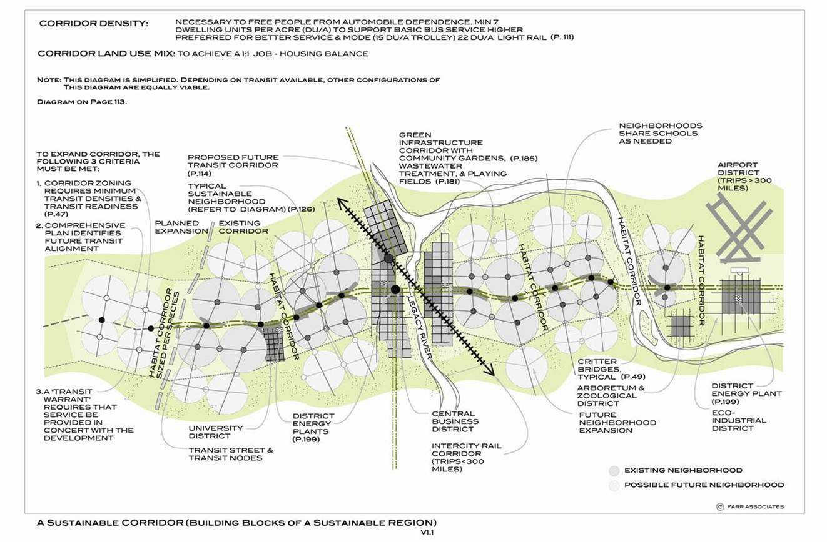
Sustainable Corridor
(Farr 2008, page 113)

Slide 3
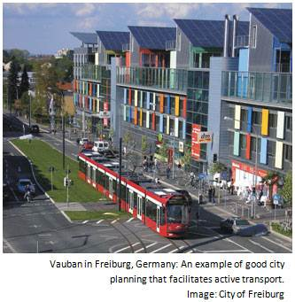
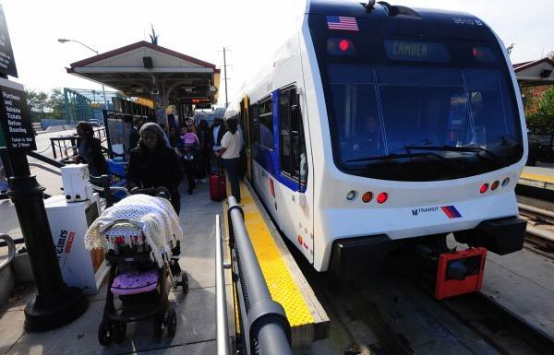
Transportation Corridors
Light Rail, Trolleys
gregormews.wordpress.com
New Jersey Transit River Line train in Trenton NJ
www.pressofatlanticcity.com, 2009
Notes:
Facts at a Glance www.publictransportation.org
From big cities, to small towns and everywhere in between public transportation is a vital resource to Americans, and a cornerstone of the nation’s economy. Relying on transit for their daily mobility needs Americans use local public transportation systems to get to and from work, or school, the doctor’s office, shopping, or visiting with family and friends; providing a vital link between residents and their communities. Public transportation reduces the nation’s dependence on foreign oil. It saves gas, and reduces congestion, all while helping reduce our carbon footprint.
Quick Facts
In 2011, Americans took 10.2 billion trips on public transportation.
35 million times each weekday, people board public transportation.
Public transportation is a $54 billion industry that employs more than 400,000 people.
More than 7,700 organizations provide public transportation in the United States.
Public Transportation Provides Economic Opportunities and Jobs
Every $1 invested in public transportation generates approximately $4 in economic returns.
Every $1 billion invested in public transportation creates or supports 36,000 jobs.
Every $10 million in capital investment in public transportation yields $30 million in increased business sales.
Every $10 million in operating investment yields $32 million in increased business sales.
Public transportation not only gets people to work it puts people to work.
Public Transportation Enhances Personal Opportunities
Public transportation provides personal mobility and freedom for people from every walk of life.
Access to public transportation gives people transportation options to get to work, go to school, visit friends, or go to a doctor’s office.
Public transportation provides access to job opportunities for millions of Americans.
83% of older Americans acknowledge public transit provides easy access to things they need in everyday life.
Public transit is a vital link for the more than 51 million Americans with disabilities.
Public Transportation Saves Fuel, Reduces Congestion
Access to bus and rail lines reduces driving by 4,400 miles per household annually.
Americans living in areas served by public transportation save 785 million hours in travel time and 640 million gallons of fuel annually in congestion reduction alone.
Without public transportation, congestion costs would have been an additional $19 billion.
Public Transportation Saves Money
Public transportation provides an affordable, and for many, necessary, alternative to driving.
Households that take public transportation, and live with one fewer car can save more than $9,900 per year.
Public Transportation Reduces Gasoline Consumption
Public transportation’s overall effects save the United States 4.2 billion gallons of gasoline annually
Households near public transit drive an average of 4,400 fewer miles than households with no access to public transit. This equates to an individual household reduction of 223 gallons per year.
Public Transportation Reduces Carbon Footprint

Slide 4
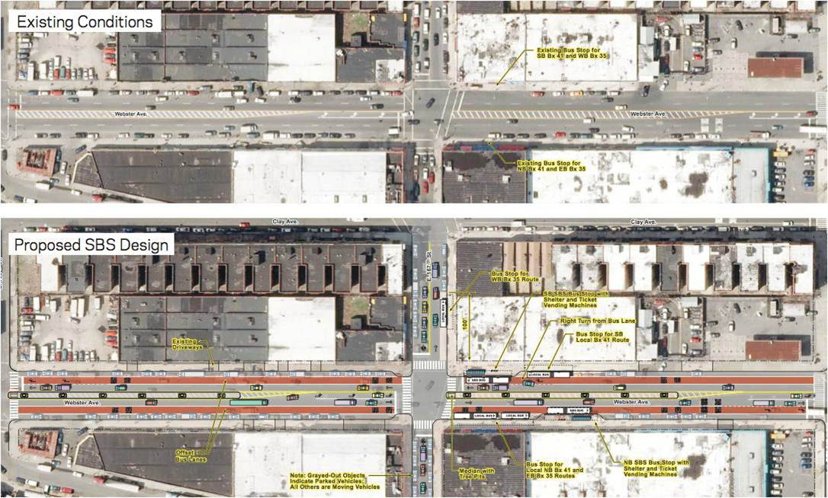
Bus (Webster Ave NYC)
SBS = Select Bus Service (Bus Rapid Transit)
www.thetransportpolitic.com, 2012

Slide 5
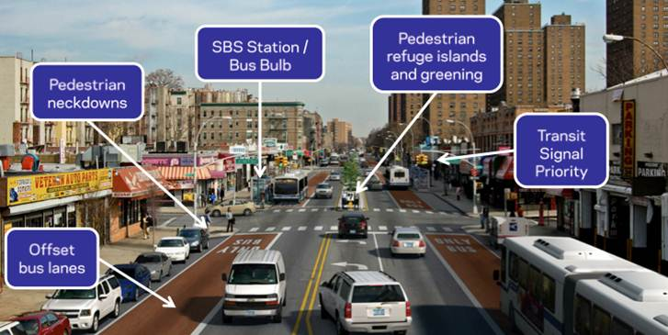
Bus (Webster Ave NYC)
www.thetransportpolitic.com, 2012

Slide 6
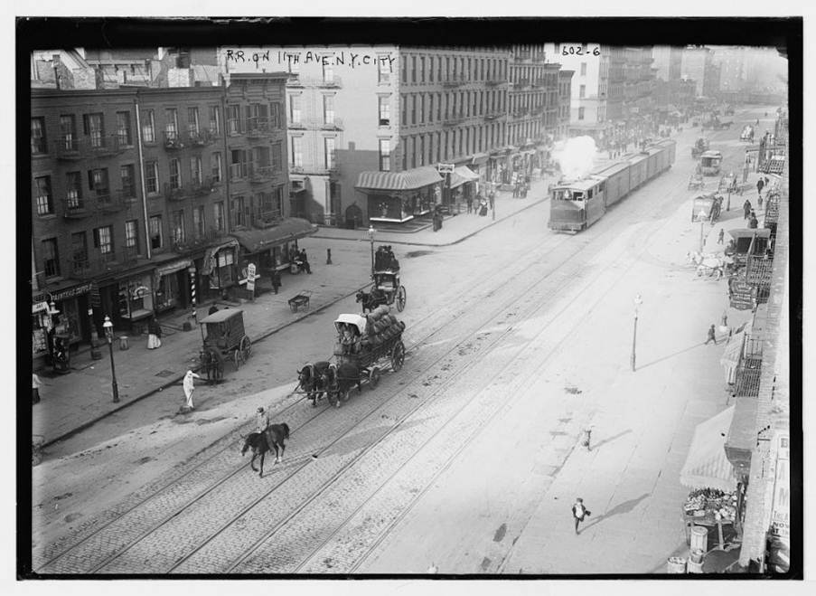
Historic - NYC 11th Ave c1900
www.businessinsider.com
Also: YouTube - Lost Film From 1906 (San Francisco)

Slide 7
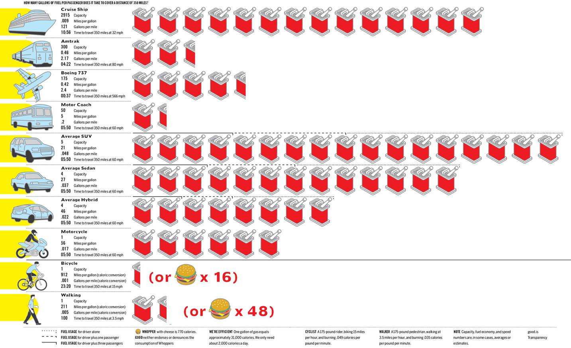
Gallons/Passenger to go 350 miles
www.good.is
Notes:
JWE – I had to fix walking gas can figure as correct answer is 1.2 gallons

Slide 8
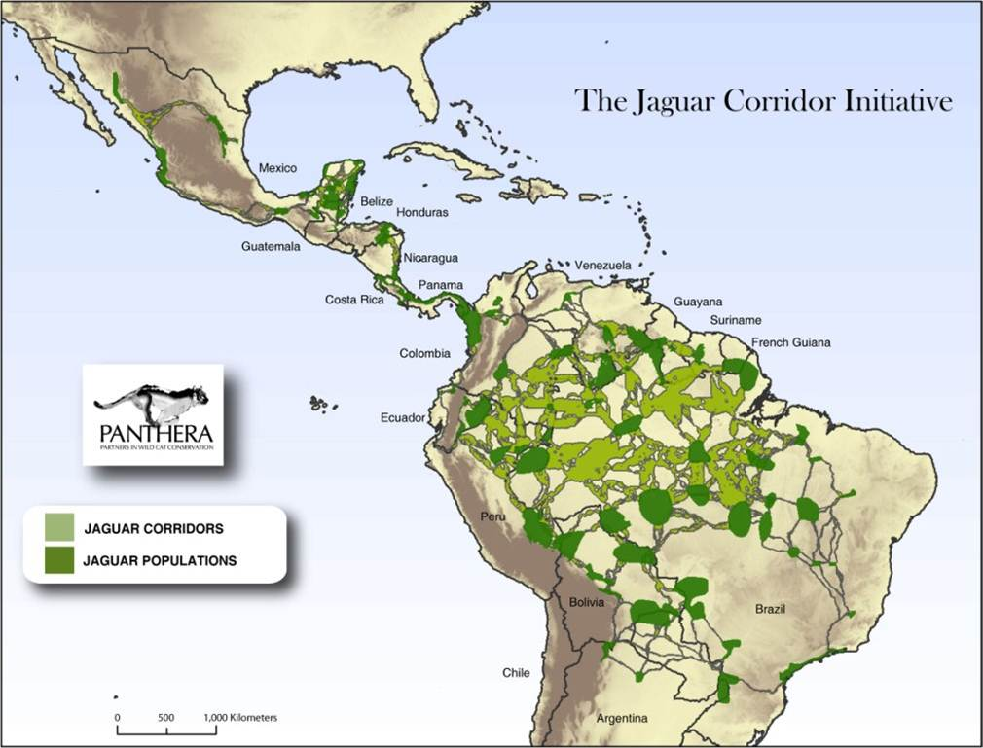
www.panthera.org, 2012

Slide 9
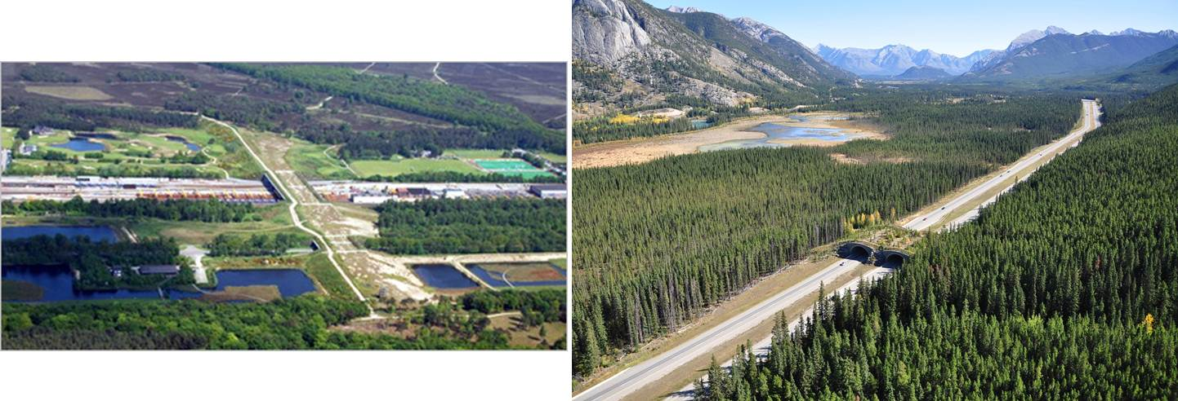
Habitat Corridors
Natuurbrug Zanderij Crailo
The Netherlands
www.conservationcorridor.org, 2012
Banff National Park, British Columbia,
www.esa.org, 2012
The Netherlands has over 600!

Slide 10
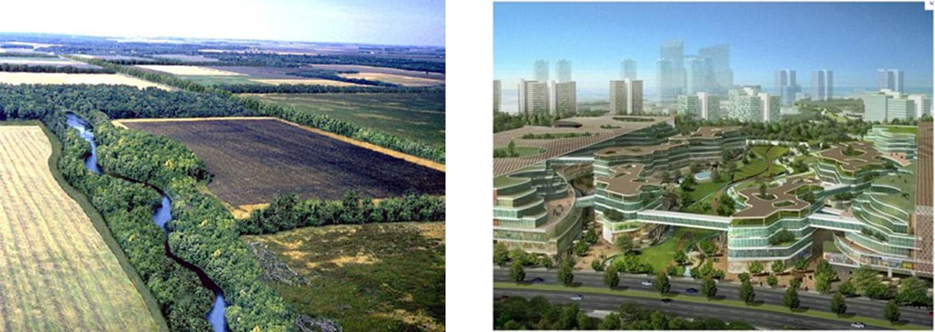
Habitat Corridors
www.ia.nrcs.usda.gov, 2005
blog.emap.com, 2012
Connectivity is good

Slide 11
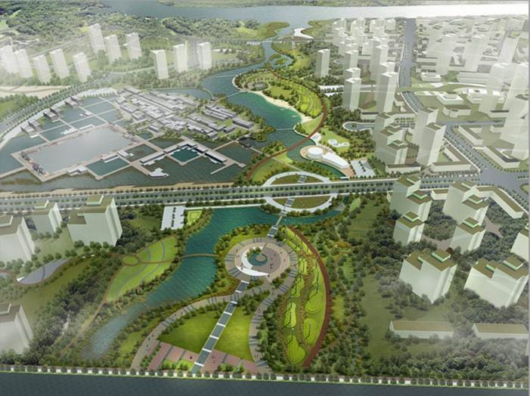
Tianjin Eco-City — Windscape Corridor (China)
urbanlabglobalcities.blogspot.com, 2011

Slide 12
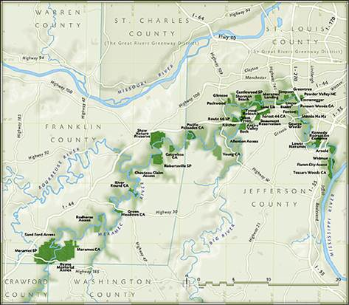
Urban – Rural Greenway
Meramec Greenway
www.meramecgreenway.org, 2012
Notes:
Welcome to the Meramec Greenway, which is located in east-central Missouri near the City of St. Louis. The Greenway follows the Meramec River from its confluence with the Mississsippi River for 108 miles into the Ozark uplands. Its natural features include springs, bluffs, caverns and expansive beaches.
Established in 1975 the Meramec Greenway now features over 28,000 acres of public parks, conservation areas and institutional lands that offer a wide spectrum of recreational and educational opportunities. Its success is a tribute to the unique partnership of governments and citizens that have cooperated for over thirty years.

Slide 13
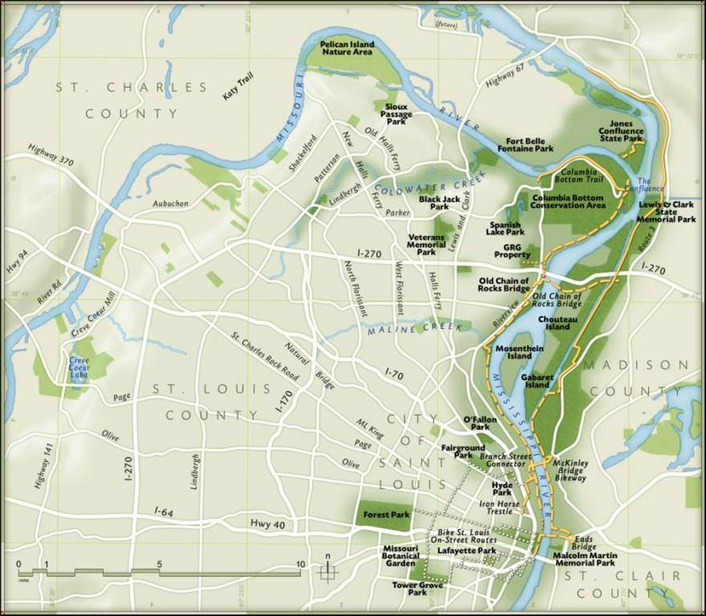
Urban Greenway – St. Louis
www.grgstl.org, 2012

Slide 14
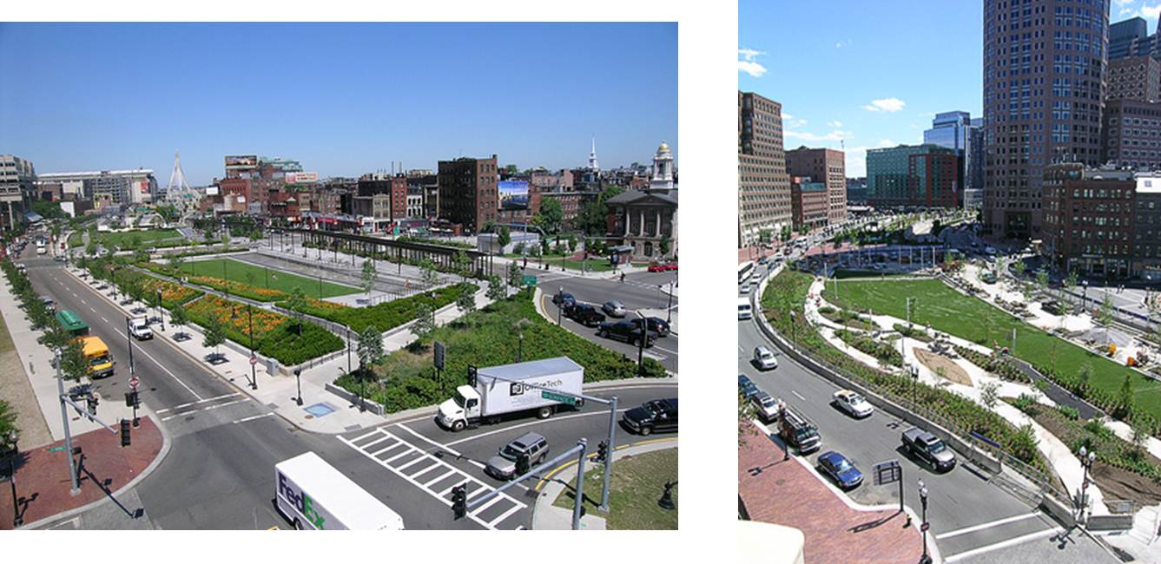
Urban Greenway
Rose Fitzgerald Kennedy Greenway
Boston
stephanierogers.typepad.com, 2008
www.bostonbyfoot.org, 2012

Slide 15
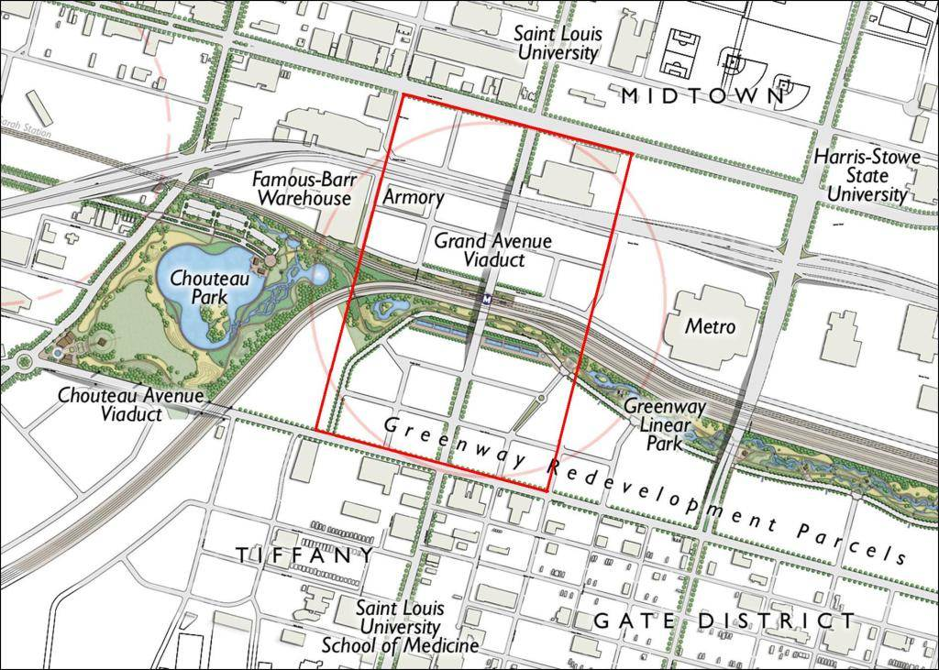
Urban Greenway
St. Louis Downtown - Proposed
udarchive.uli.org, 2006

Slide 16
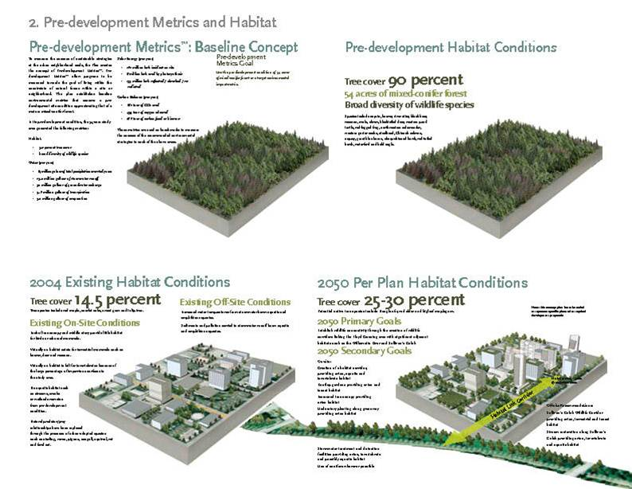
Greening
Lloyd District - Portland, Oregon
aiatopten.org, 2005

Slide 17
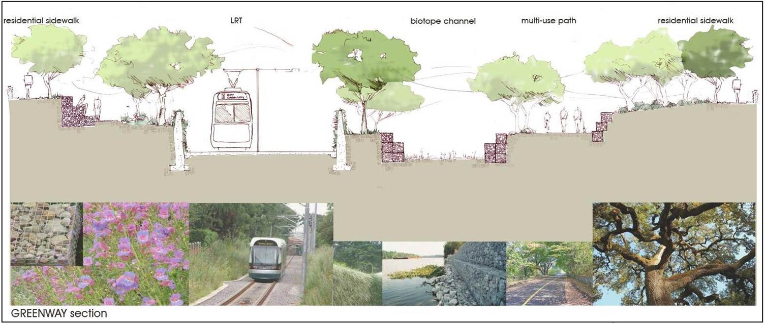
Proposed Greenway – Light Rail
Greater Los Angeles County Region
www.expogreenway.org

Slide 18
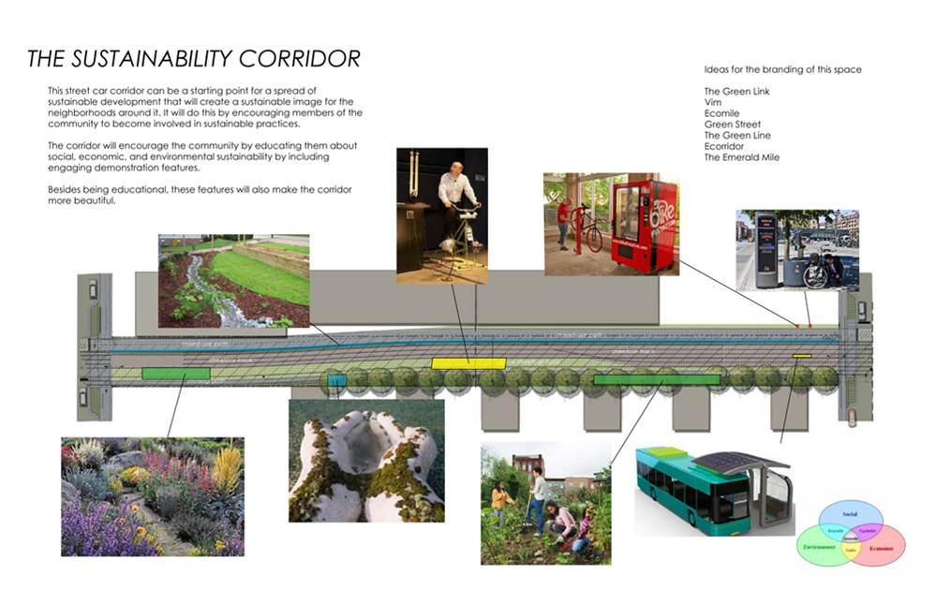
Sugar House Streetcar Greenway, Salt Lake City, UT
vodaplan.com

Slide 19
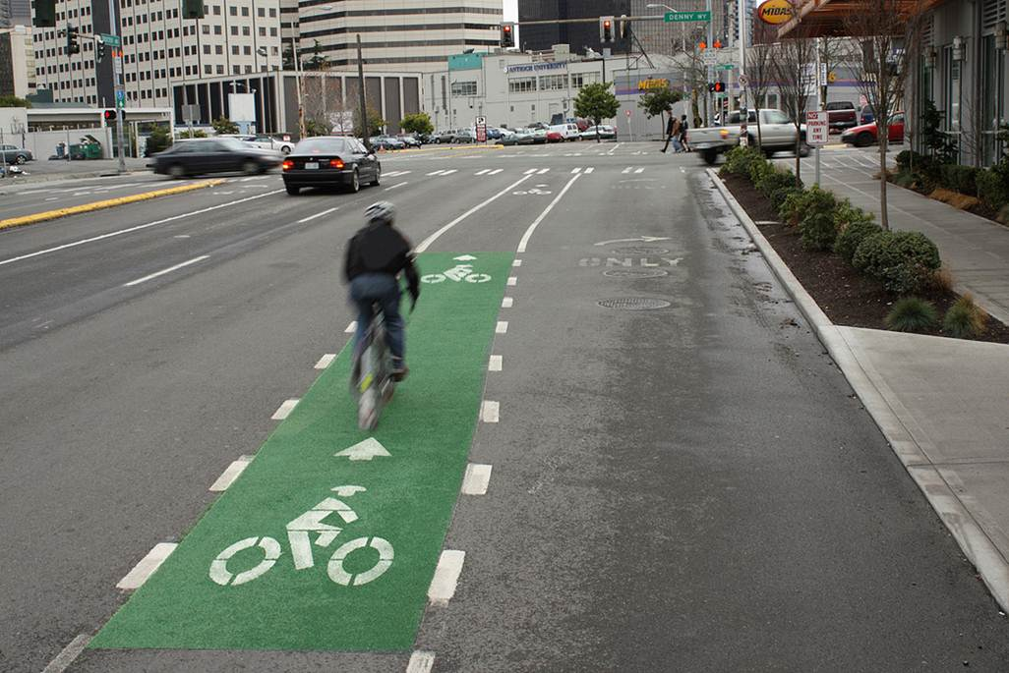
Bike Lane (Seattle 2010)
/thecityfix.com

Slide 20
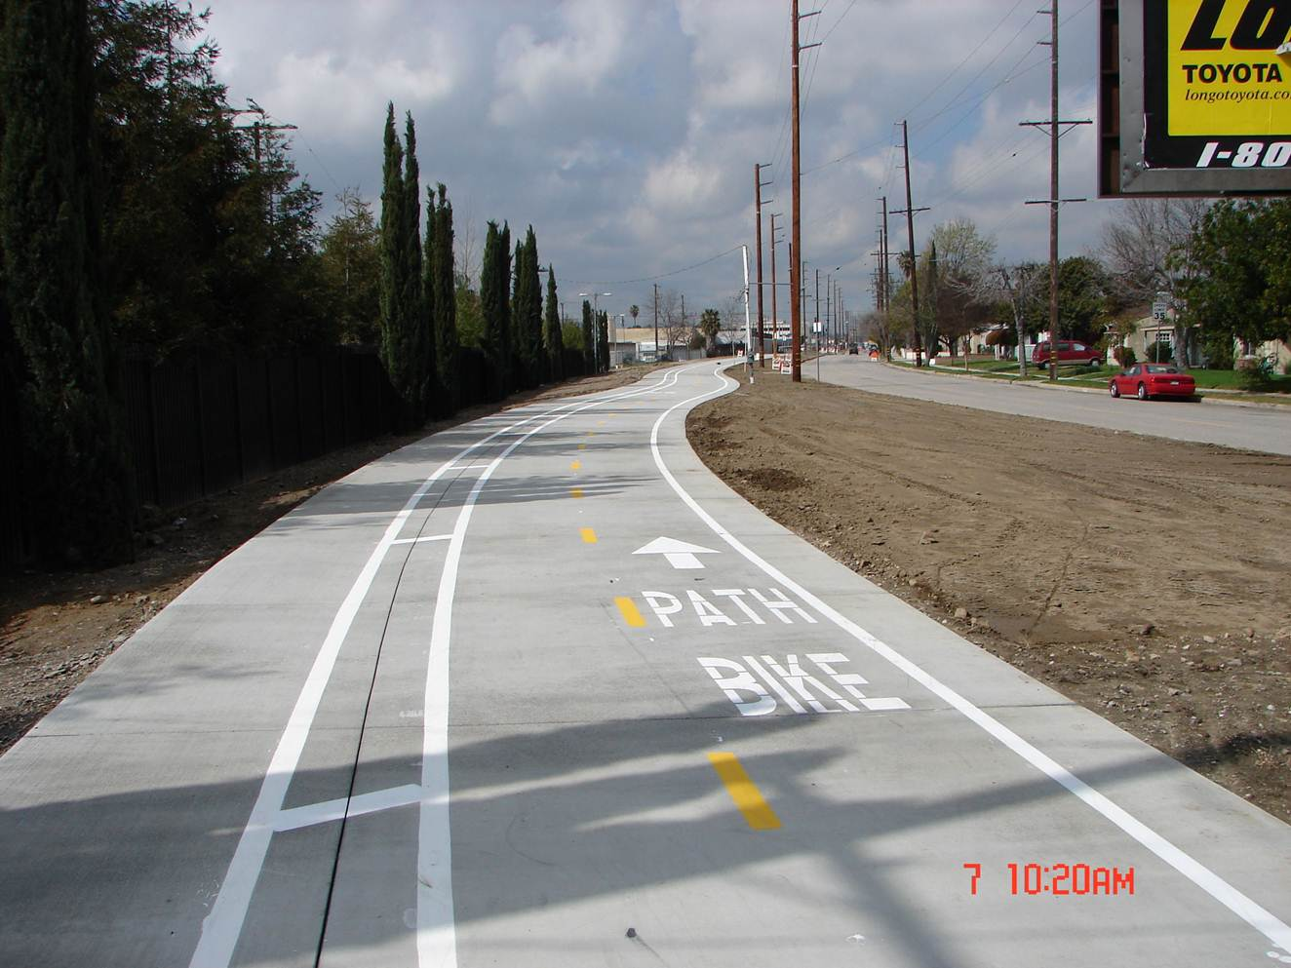
Bike Paths (LA 2010 Chandler Blvd)
maxlancecomedy.com
Notes:
One of the newest bicycle right-of-ways in the city, this stretches across nearly the entire valley floor from one side of boring, ghetto suburbia to the other. There’s not a lot of sun cover, which makes the Chandler path useless from May through October, and you have to stop frequently at intersections, but it’s usually empty, fast and well paved. Great way to get from the strip malls of Van Nuys to the shopping plazas of Burbank.

